Slide 1
11.11 Aggregation and Composition (Composition discussed in Chapter 7)
Class aggregation: An object of one class owns an object of another class
Class composition: A form of aggregation where the enclosing class controls the lifetime of the objects of the enclosed class
Supports the modeling of ‘has-a’ relationship between classes – enclosing class ‘has a(n)’ instance of the enclosed class

Slide 2
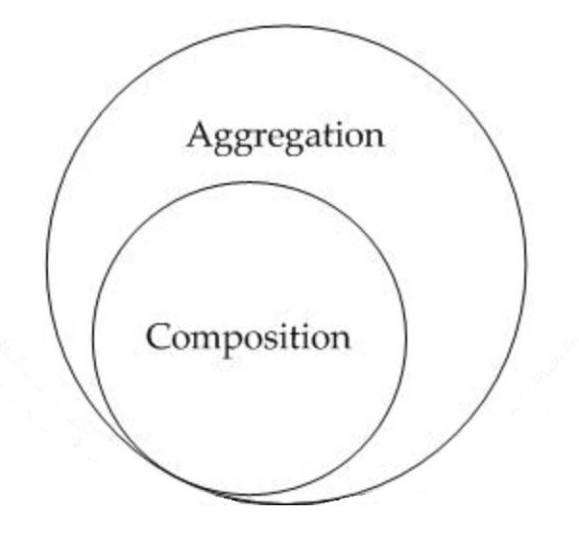
Aggregation and Composition

Slide 3
Aggregation and Composition
In both aggregation and composition, the object of one class “owns” an object of another class.
With aggregation, the dependent object is standalone and can exist even if the owning class is not existent.
In composition, the object of the class that is owned by the object of it’s owning class cannot live on it’s own (also called “death relationship”). It will only live as a part of its owning object.

Slide 4
Aggregation, Composition, and Object Lifetimes
Composition is a form of aggregation in which the lifetime of the owned object is the same as that of the owner object
Owned object is usually created as part of the owning object’s constructor, destroyed as part of owning object’s destructor

Slide 5
Aggregation Example
Consider a generalized Car class and a Wheel class.
Car needs a Wheel object to function,
but Wheel can exist without a Car - it may be used in a Bike, Truck, Motorcycle, etc.

Slide 6
Composition Example
Now consider a Car class and a engine class that is a specific type of engine, called SpecificEngine that is specific to that car, meaning that it cannot be used in any other car.
For example, a Mazda RX8 (and RX7) has a rotary engine. Very few cars have a rotary engine.
An object of Car class cannot exist without an object of SpecificEngine class, and an object of SpecificEngine has no significance without Car class.
i.e., Car class solely “owns” the SpecificEngine class

Slide 7
Object Composition
class StudentInfo {
private:
string firstName, lastName;
...
};
class Student {
private:
StudentInfo personalData;
...
publice:
Student(string fname, string lname) {
firstName = fname;
lastName = lname;
}
};
Notes:
When a student object is created, so is the StudentInfo data member object called personalData. When the student object is destroyed, so is the StudentInfo data member object called personalData.

Slide 8
Member Initialization Lists
Used in constructors for classes involved in aggregation.
Allows constructor for enclosing class to pass arguments to the constructor of the enclosed class
Notation:
owner_class(parameters):owned_class(parameters);

Slide 9
Member Initialization Lists
Use:
class StudentInfo {
string firstName, lastName;
...
};
class Student {
private:
StudentInfo personalData;
public:
Student(string fname, string lname):
StudentInfo(fname, lname);
};

Slide 10
Member Initialization Lists
Member Initialization lists can be used to simplify the coding of constructors
Should keep the entries in the initialization list in the same order as they are declared in the class

Slide 11
Object Composition
class Date {
private:
string month;
int day, year;
public:
Date(string m, int d, int y): // initialization list
month(m), day(d), year(y) {}
};
class Person {
private:
string name;
Date dateOfBirth;
public:
Person(string name, string month, int day, int year):
dateOfBirth(month, day, year) // init list
{
this->name = name;
}
};

Slide 12
Object Composition
class Date {
private:
string month;
int day, year;
public:
Date(string m, int d, int y):
month(m),day(d), year(y) {}
};
class Person {
private:
string name;
Date dateOfBirth;
public:
Person(string name, string month, int day, int year):
name(name), dateOfBirth(month, day, year) {}
};
Notes:
It is preferred to use member initialization lists over assignment inside the body of the constructor because it allows the compiler to generate more efficient code in certain situations. It is good practice to list the members in the same order that they are declared in the class.
Notice the occurrence of name(name) in the initialization list of the Person constructor. The compiler is able to determine that the first occurrence of name refers to the member variable and that the second occurrence refers to the parameter.

Slide 13
Aggregation Through Pointers
A ‘has-a’ relationship can be implemented by owning a pointer to an object
Can be used when multiple objects of a class may ‘have’ the same attribute for a member
ex: students who may have the same city/state/ zipcode or country
Using pointers minimizes data duplication and saves space

Slide 14
Aggregation Through Pointers
class Date {
private:
string month;
int day, year;
… // rest is the same as before
};
class Country {
private:
string name;
… // possibly other fields
};
class Person {
private:
string name;
Date dateOfBirth;
shared_ptr<Country> pCountry;
public:
Person(string name, string month, int day, int year,
shared_ptr<Country>& pC):
name(name), dateOfBirth(month, day, year),
pCountry(pC) {}
};
Notes:
Because many people will ”have” the same country, the has-a relationship between Person and Country should not be implemented by embedding an instance of the Country class inside every Person object; this would result in unnecessary duplication of data and waste memory.
Also, if Country had any changes in any of its data, many Person objects may need to be updated to reflect those changes.
Program 11-21 shows modified versions of the above classes designed to illustrate aggregation, composition, and object lifetimes. Each class has a constructor to announce the creation of its objects and a destructor to announce their destruction. The Person class also has a static member
int Person::uniquePersonID;
that is used to generate numbers assigned to the Person objects as they are created. These numbers serve as a sort of universal personl identification number. The numbers are stored in the personID field of the Person and Data classes and are used to identify objects being created or destroyed. Each dateOfBirth object carries the same personID number as the Person object that contains it.

